Slide 1










Introduction to
Algorithm Design and Analysis
[6] MergeSort
Yu Huang
http://cs.nju.edu.cn/yuhuang Institute of Computer Software Nanjing University

Slide 2

In the last class…
Heap
FixHeap
ConstructHeap
HeapSort
Complexity
Accelerated HeapSort

Slide 3

MergeSort
MergeSort
Worst-case analysis of MergeSort
Lower Bounds for comparison-based sorting
Worst-case
Average-case

Slide 4


MergeSort: the Strategy
Easy division
No comparison is done during the division
Minimizing the size difference between the divided subproblems
Merging two sorted subranges
Using Merge

Slide 5
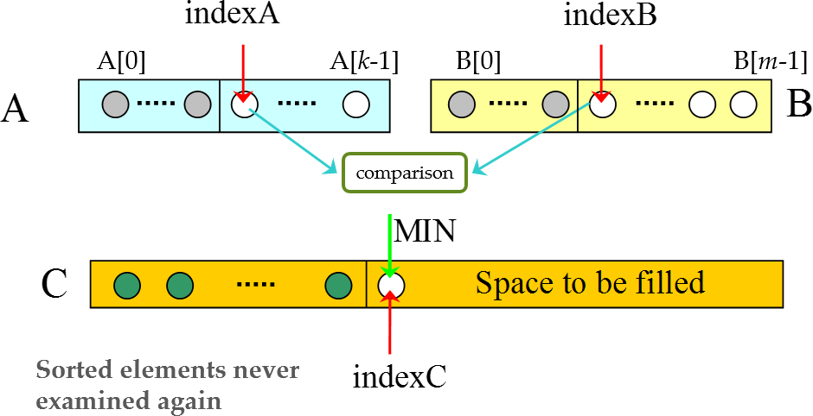
Merging Sorted Arrays

Slide 6

Merge: the Specification
Input
Array A with k elements and B with m elements, whose keys are in non-decreasing order
Output
Array C containing n = k + m elements from A and B in non-decreasing order
C is passed in and the algorithm fills it

Slide 7



Merge: Recursive Version
merge(A,B,C)
if (A is empty)
rest of C = rest of B
else if (B is empty) rest of C = rest of A
Base cases
else
if (first of A ≤ first of B) first of C =first of A
merge(rest of A, B, rest of C)
else
first of C =first of B
merge(A, rest of B, rest of C)
return

Slide 8



Worst Case Complexity of Merge
Observations
Worst case is that the last comparison is conducted between A[k-1] and B[m-1]
After each comparison, one element is inserted into Array C, at least.
After entering Array C, an element will never be compared again
After the last comparison, at least two elements (the two just compared) have not yet been moved to Array
C. So at most n-1 comparisons are done.
In worst case, n-1 comparisons are done, where n=k+m

Slide 9




Optimality of Merge
Any algorithm to merge two sorted arrays, each containing k=m=n/2 entries, by comparison of keys, does at least n-1 comparisons in the worst case.
Choose keys so that:
b₀<a₀<b₁< a₁<...<b_{i}<a_{i}<b_{i+1},...,<b_{m-1}<a_{k-1}
Then the algorithm must compare a_{i} with b_{i} for every i in [0,m-1], and must compare a_{i} with b_{i+1} for every i in [0, m-2], so, there are n-1 comparisons.
Valid for |k-m|≤1, as well.

Slide 10

Space Complexity of Merge
A algorithm is “in space”, if the extra space it has to use is in Θ(1)
Merge is not a algorithm “in space”, since it need enough extra space to store the merged sequence during the merging process.

Slide 11











Overlapping Arrays for Merge
extra
Before the merge
space
0
k-1
k+m-1
0
B
m-1
A
Merge from the right
Partly finished
Merged
0
k-1
k+m-1
0
m-1
0
Finished
k-1
k+m-1
0
m-1
A/C

Slide 12
MergeSort
Input: Array E and indexes first, and last, such that the elements of E[i] are defined for first≤i≤last.
Output: E[first],…,E[last] is a sorted rearrangement of the same elements.
Procedure
void mergeSort(Element[] E, int first, int last)
if (first<last)
int mid=(first+last)/2; mergeSort(E, first, mid); mergeSort(E, mid+1, last); merge(E, first, mid, last)
return

Slide 13


Analysis of MergeSort
The recurrence equation for Mergesort
o W(n)=W(⎣n/2⎦)+W(⎡n/2⎤)+n-1
o W(1)=0
Where n=last-first+1, the size of range to be sorted
The Master Theorem applies for the equation, so:
W(n)∈Θ(nlogn)

Slide 14


Recursion Tree for Mergesort
n-1 Level 0
Base cases occur at depth ⎡lg(n+1)⎤-1 and ⎡lg(n+1)⎤
n-2 Level 1
n-4
Level 2
n-8
Level 3
Note:
nonrecursive costs on level k is n-2^{k} for all level without basecase node
T(n)
n-1
T(n/2)
n/2-1
k/2 may be
⎡k/2⎤ or
⎣k/2⎦
T(n/4)
n/4-1
T(n/8)
n/8-1

Slide 15





Non-complete Recursion Tree
Example: n=11
2^{D-1} nodes
B base-case nodes on the second lowest level
Since each nonbase-case node has 2 children, there are (n-B)/2 nonbase-case nodes at depth D-1
n-B base-case nodes No nonbase-case nodes
at this depth

Slide 16


Number of Comparison of MergeSort
The maximum depth D of the recursive tree is ⎡log(n+1)⎤.
Let B base case nodes on depth D-1, and n-B on depth D, (Note: base case node has nonrecursive cost 0).
(n-B)/2 nonbase case nodes at depth D-1, each has nonrecursive cost 1.
So:
D-2
W( n ) =∑( n - 2^{d} ) +
n - B n - B
= n( D -1) ( 2^{D-1} -1) +
d =0
2 2
Since ( 2^{D} - 2B ) + B = n, that is B = 2^{D} - n So,W( n ) = nD - 2^{D} +1
₂D
B
Let = 1+ _{n} = α, then 1≤ α < 2,
D = logn + logα
n
So,W( n ) = nlogn -( α - logα )n +1
⎡nlog(n)-n+1⎤ ≤ number of comparison ≤ ⎡nlog(n)-0.914n⎤

Slide 17


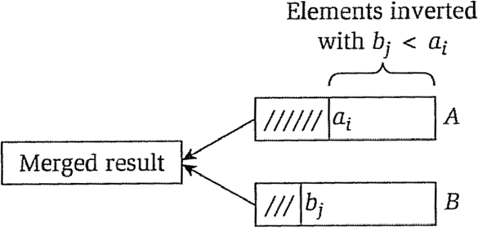
The MergeSort D&C
Counting the number of inversions
Brute force: O(n²)
Divide & conquer: O(nlogn)
MergeSort as the carrier
If a_{i}<b_{i}
Increase counter by the number of elements remaining in A

Slide 18








The MergeSort D&C
Max-sum subsequence
Finding the frequent
element
Find the nearest two points on the plane
Counting inversions
…
Just evenly divide
Linear-time combination
T(n)=2T(n/2)+O(n)
T(n)=O(nlogn)

Slide 19




Lower Bounds for Comparison-based Sorting
Upper bound, e.g., worst-case cost
For any possible input, the cost of the specific algorithm A is no more than the upper bound
𝑀𝑀𝑀𝑀𝑀𝑀 𝐶𝐶𝐶𝐶𝐶𝐶𝐶𝐶 𝑖𝑖 𝑖𝑖 𝑖𝑖𝐶𝐶 𝑀𝑀𝑎𝑎 𝑖𝑖𝑎𝑎𝑖𝑖𝑖𝑖𝐶𝐶}
Lower bound, e.g., comparison-based sorting
For any possible (comparison-based) sorting algorithm A, the worst-case cost is no less than the lower bound
Min{Worst-case(a) | a is an algorithm}

Slide 20



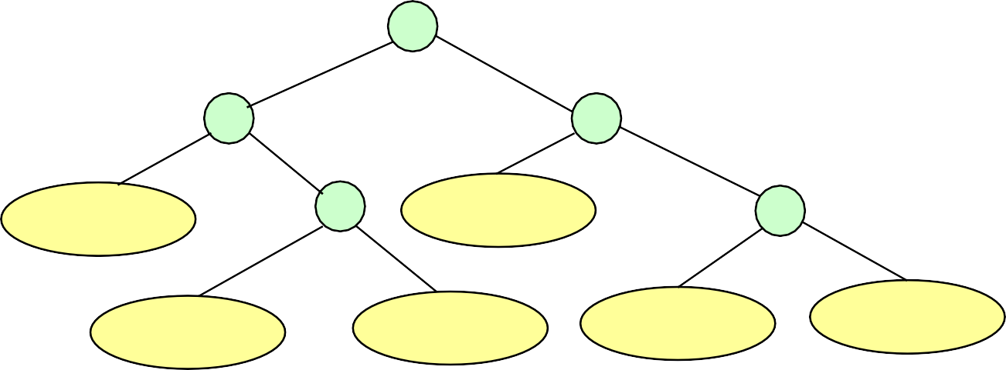


Decision Tree for Sorting
Internal node
1:2
A example for n=3
2:3
1:3
x₁,x₂,x₃
1:3
x₂,x₁,x₃
2:3
External node
x₃,x₁,x₂
x₂,x₃,x₁
x₃,x₂,x₁
x₁,x₃,x₂
Decision tree is a 2-tree (Assuming no same keys)
The action of Sort on a particular input corresponds to following on path in its decision tree from the root to a leaf associated to the specific output

Slide 21



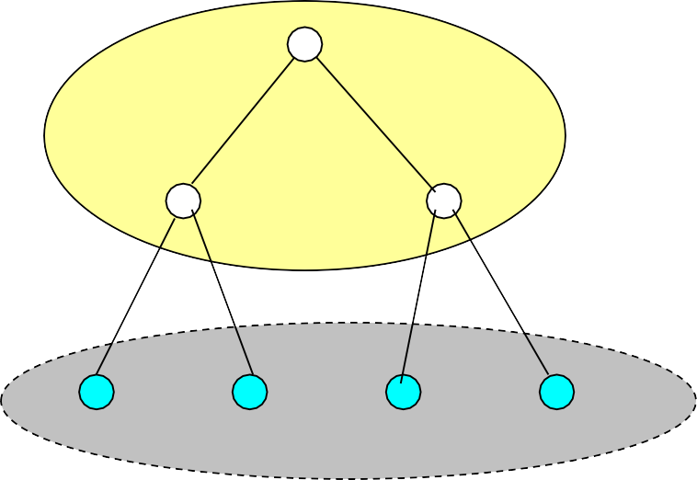






2-Tree
2-Tree
Common Binary
internal nodes
Tree
Both left and right children of these nodes are empty tree
external nodes no child any type

Slide 22



Characterizing the Decision Tree
For a sequence of n distinct elements, there are n! different permutation
So, the decision tree has at least n! leaves, and exactly n! leaves can be reached from the root.
So, for the purpose of lower bounds evaluation, we use trees with exactly n! leaves.
The number of comparison done in the worst case is the height of the tree.
The average number of comparison done is the average of the lengths of all paths from the root to a leaf.

Slide 23

Lower Bound for Worst Case
Theorem: Any algorithm to sort n items by comparisons of keys must do at least ⎡log n!⎤, or approximately
⎡nlogn-1.443n⎤, key comparisons in the worst case.
Note: Let L=n!, which is the number of leaves, then L≤2^{h}, where h is the height of the tree, that is
h≥ ⎡logL⎤=⎡logn!⎤
Lemma: let L be the number of leaves in a binary tree and h be its height. Then L≤2^{h}
For the asymptotic behavior:

Slide 24

External Path Length(EPL)
EPL – sum of path length to every leaf
The EPL t is recursively defined as follows:
[Base case] 0 for a single external node
[Recursion] t is non-leaf with sub-trees L and R, then the sum of:
the external path length of L;
the number of external node of L;
the external path length of R;
the number of external node of R;

Slide 25





More Balanced 2-tree, Less EPL
Guess and prove:
𝑒𝑒𝑖𝑖𝑒𝑒 ≥ 𝐿𝐿𝑒𝑒𝐶𝐶𝐿𝐿𝐿𝐿
X
level k
X
level k+1
Y
level h-1
Y
level h
Assuming that h-k>1, when calculating epl, h+h+k is replaced by (h-1)+2(k+1). The net change in epl is k- h+1<0, that is, the epl decreases.

Slide 26






Properties of EPL
Let t be a 2-tree, then the epl of t is the sum of the paths from the root to each external node.
epl ≥mlog(m), where m is the number of external nodes in t
o epl=epl_{L}+epl_{R}+m≥ m_{L}log(m_{L})+m_{R}log(m_{R})+m,
note f(x)+f(y)≥2f((x+y)/2) for f(x)=xlogx
o so,
epl ≥ 2((m_{L}+m_{R})/2)log((m_{L}+m_{R})/2)+m
p. 116, Lemma
= m(log(m)-1)+m =mlogm.
3.7 of [Baase01]

Slide 27



Lower Bound for Average Behavior
Since a decision tree with L leaves is a 2-tree, the average path length from the root to a leaf is ^{epl} .
o Recall that epl ≥ Llog(L).
L
Theorem: The average number of comparison done by an algorithm to sort n items by comparison of keys is at least log(n!), which is about nlogn-1.443n.

Slide 28



MergeSort Has Optimal Average Performance
The average number of comparisons done by an algorithm to sort n items by comparison of keys is at least about nlogn-1.443n
The worst complexity of MergeSort is in
Θ(nlogn)
So, MergeSort is optimal as for its average performance

Slide 29


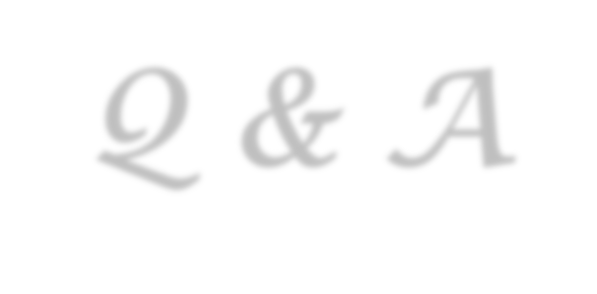

Thank you!
Q & A
Yu Huang
http://cs.nju.edu.cn/yuhuang

